Slide 1
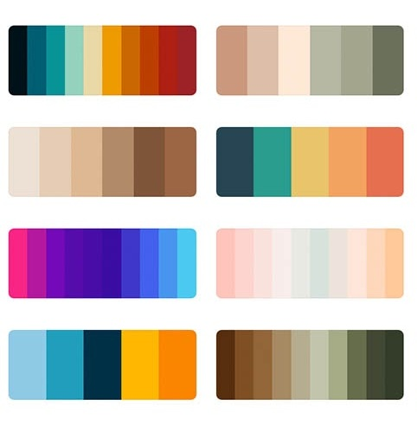
Color Palettes
Author: Tural Hajiyev (270010)

Slide 2
The subject of the project
To be able to find useful colors and color palettes to use in content creation and development.
To be able to save favorite colors and color palettes in one place.
To converted multiple color formats to each other.

Slide 3
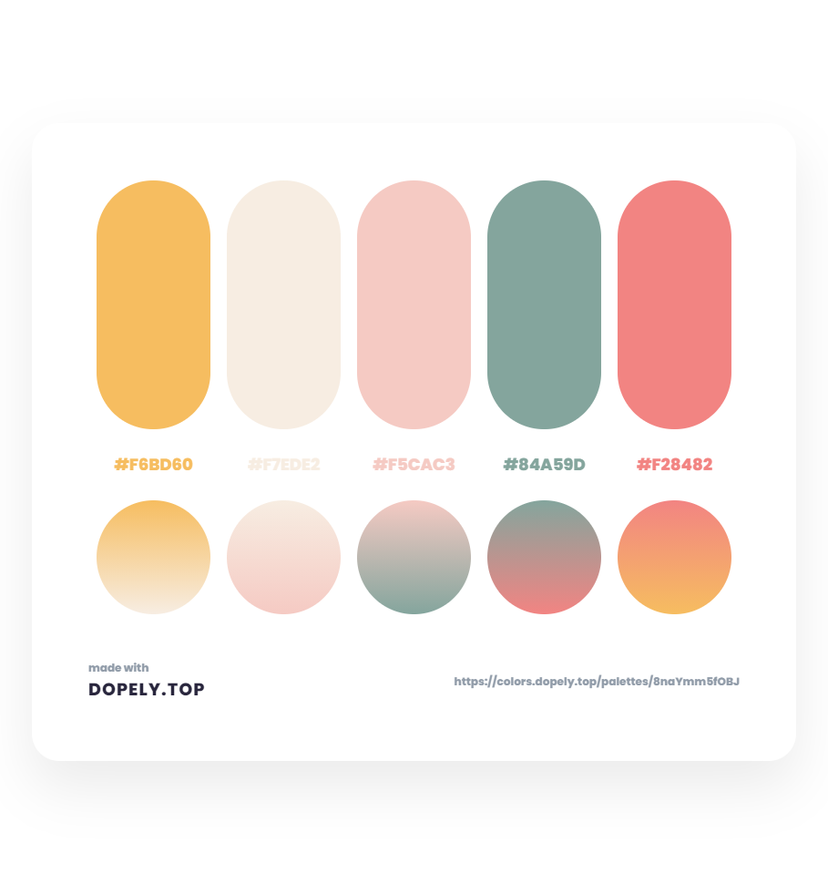
Justification
Why are you going to do it?
Single source application to keep track of colors.
Find a material and cool colors to use in different kind of projects.
Generate color palettes based on specific color easily.

Slide 4
Project scope and risks
Scopes
Risks
Find random colors and color palettes easily
Access to your favorite colors and color palettes from one source
Convert different color formats to each other
A lot of applications like that
Need to have domain and hosting to publish application and keep up-to-date (additional cost)

Slide 5
Features to be implemented
Primary (must have)
Secondary (extended)
Users should be able to see random colors and color palettes.
Users should be able to convert one color format to another.
Users should be able to generate new pairs and save favorite ones
Users should be able to share favorite colors and color palettes in Twitter
Users should be able to share favorite color palettes with others.

Slide 6
Deployment & hardware requirements
Install / Deploy technologies
Hard / Software requirements
Yarn
nextJS
docker
vercel
laptop or pc;
>4 gb rams;
internet connection;
stable browser – google chrome, mozilla, opera, safari;

Slide 7
State of Art
Color Hunt – It helps end users to find color palettes for websites.
Convert Color – Web application which helps end users to convert colors from one format to others
My Color Space – Web application to generate color palettes and gradients based on specific color

Slide 8
Milestones
First month
General Layout of application
Generate random colors and color pallets (first page and second page)
Add feature to save favorite colors and color palettes
Second month
Create color palettes based on selected color (third page)
Convert colors to different formats (fourth page)
Third month
Unit tests
Deployment

Slide 9
References
https://colorhunt.co/
https://convertacolor.com/
https://mycolor.space/
https://trello.com/b/3FxuW7WF/mmcvthu0730coolorapp
https://github.com/turalowski

